Slide 1
Data Structure and Algorithm CSE- 225
Dr. Mohammad Abu Yousuf
yousuf@juniv.edu

Slide 2

Hash Table
A hash table is a collection of items which are stored in such a way as to make it easy to find them later. Each position of the hash table, often called a slot, can hold an item and is named by an integer value starting at 0. For example, we will have a slot named 0, a slot named 1, a slot named 2, and so on. Initially, the hash table contains no items so every slot is empty. Figure shows a hash table of size m=11. In other words, there are m slots in the table, named 0 through 10.

Slide 3
Hashing
The mapping between an item and the slot where that item belongs in the hash table is called the hash function.
The hash function will take any item in the collection and return an integer in the range of slot names, between 0 and m-1. Assume that we have the set of integer items 54, 26, 93, 17, 77, and 31.

Slide 4
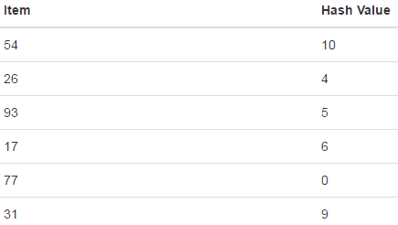
Hashing
Our first hash function, sometimes referred to as the “remainder method,” simply takes an item and divides it by the table size, returning the remainder as its hash value (h(item)=item%11). Following table gives all of the hash values for our example items.

Slide 5

Hashing
Once the hash values have been computed, we can insert each item into the hash table at the designated position as shown in following figure.
Now when we want to search for an item, we simply use the hash function to compute the slot name for the item and then check the hash table to see if it is present. This searching operation is O(1), since a constant amount of time is required to compute the hash value and then index the hash table at that location. If everything is where it should be, we have found a constant time search algorithm.

Slide 6
Hashing
Here, consider an example of hash table of size 20, and the following items are to be stored. Item are in the (key,value) format.

Slide 7
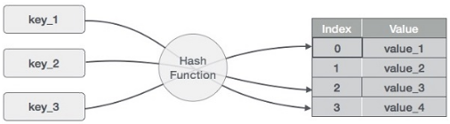

Hashing

Slide 8
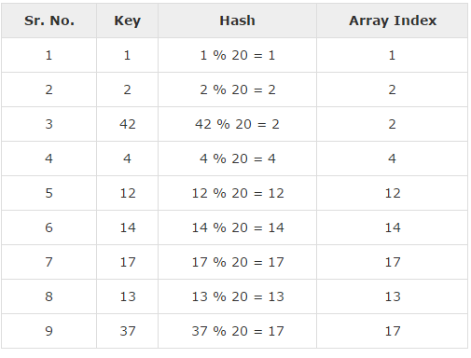
Hashing

Slide 9
Perfect hash function
Given a collection of items, a hash function that maps each item into a unique slot is referred to as a perfect hash function.
If we know the items and the collection will never change, then it is possible to construct a perfect hash function.
Unfortunately, given an arbitrary collection of items, there is no systematic way to construct a perfect hash function. Luckily, we do not need the hash function to be perfect to still gain performance efficiency.

Slide 10
Perfect hash function
One way to always have a perfect hash function is to increase the size of the hash table so that each possible value in the item range can be accommodated. This guarantees that each item will have a unique slot.
Although this is practical for small numbers of items, it is not feasible when the number of possible items is large. For example, if the items were nine-digit Social Security numbers, this method would require almost one billion slots. If we only want to store data for a class of 25 students, we will be wasting an enormous amount of memory.

Slide 11
Collision
You can probably already see that this technique is going to work only if each item maps to a unique location in the hash table. For example, if the item 44 had been the next item in our collection, it would have a hash value of 0 (44%11==0). Since 77 also had a hash value of 0, we would have a problem. According to the hash function, two or more items would need to be in the same slot. This is referred to as a collision (it may also be called a “clash”). Clearly, collisions create a problem for the hashing technique.

Slide 12
Collision
Our goal is to create a hash function that minimizes the number of collisions, is easy to compute, and evenly distributes the items in the hash table. There are a number of common ways to extend the simple remainder method. We will consider a few of them here.

Slide 13
Folding method
The folding method for constructing hash functions begins by dividing the item into equal-size pieces (the last piece may not be of equal size).
These pieces are then added together to give the resulting hash value.
For example, if our item was the phone number 436-555-4601, we would take the digits and divide them into groups of 2 (43,65,55,46,01).

Slide 14
Folding method
After the addition, 43+65+55+46+01, we get 210. If we assume our hash table has 11 slots, then we need to perform the extra step of dividing by 11 and keeping the remainder. In this case 210 % 11 is 1, so the phone number 436-555-4601 hashes to slot 1.
Some folding methods go one step further and reverse every other piece before the addition. For the above example, we get 43+56+55+64+01=219 which gives 219 % 11=10219 % 11=10.

Slide 15
Mid-square method
Another numerical technique for constructing a hash function is called the mid-square method. We first square the item, and then extract some portion of the resulting digits.
For example, if the item were 44, we would first compute 44²=1,936. By extracting the middle two digits, 93, and performing the remainder step, we get 5 (93 % 11).

Slide 16
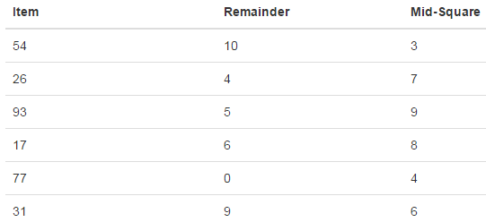
Mid-square method
Table shows items under both the remainder method and the mid-square method. You should verify that you understand how these values were computed.

Slide 17
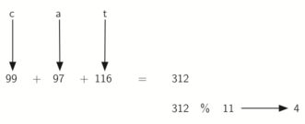
Mid-square method
We can also create hash functions for character-based items such as strings. The word “cat” can be thought of as a sequence of ordinal values (ASCII).
C=99, a=97, t=116
We can then take these three ordinal values, add them up, and use the remainder method to get a hash value (see Figure).

Slide 18
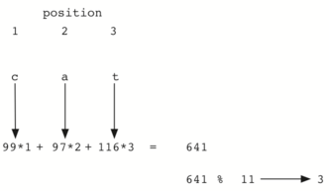
Mid-square method
It is interesting to note that when using this hash function, anagrams will always be given the same hash value. To remedy this, we could use the position of the character as a weight. Figure shows one possible way to use the positional value as a weighting factor.

Slide 19
Collision Resolution
We now return to the problem of collisions. When two items hash to the same slot, we must have a systematic method for placing the second item in the hash table. This process is called collision resolution.
As we stated earlier, if the hash function is perfect, collisions will never occur. However, since this is often not possible, collision resolution becomes a very important part of hashing.

Slide 20
Linear probing
One method for resolving collisions looks into the hash table and tries to find another open slot to hold the item that caused the collision.
A simple way to do this is to start at the original hash value position and then move in a sequential manner through the slots until we encounter the first slot that is empty.
Note that we may need to go back to the first slot (circularly) to cover the entire hash table. This collision resolution process is referred to as open addressing in that it tries to find the next open slot or address in the hash table.
By systematically visiting each slot one at a time, we are performing an open addressing technique called linear probing.

Slide 21
Linear probing
Initially assume that we have the set of integer items 54, 26, 93, 17, 77, and 31.
(h(item)=item%11).
Here 11=hash table size

Slide 22
Linear probing
Now consider, we want to keep 44, 55, 20 in the same hash table.
When we attempt to place 44 into slot 0, a collision occurs. Under linear probing, we look sequentially, slot by slot, until we find an open position. In this case, we find slot 1.
Again, 55 should go in slot 0 but must be placed in slot 2 since it is the next open position.

Slide 23

Linear probing
The final value of 20 hashes to slot 9. Since slot 9 is full, we begin to do linear probing. We visit slots 10, 0, 1, and 2, and finally find an empty slot at position 3.

Slide 24
Linear probing: Searching
Once we have built a hash table using open addressing and linear probing, it is essential that we utilize the same methods to search for items.
Assume we want to look up the item 93. When we compute the hash value, we get 5. Looking in slot 5 reveals 93, and we can return True.
What if we are looking for 20? Now the hash value is 9, and slot 9 is currently holding 31. We cannot simply return False since we know that there could have been collisions. We are now forced to do a sequential search, starting at position 10, looking until either we find the item 20 or we find an empty slot.

Slide 25

Clustering
A disadvantage to linear probing is the tendency for clustering; items become clustered in the table. This means that if many collisions occur at the same hash value, a number of surrounding slots will be filled by the linear probing resolution. This will have an impact on other items that are being inserted, as we saw when we tried to add the item 20 above. A cluster of values hashing to 0 had to be skipped to finally find an open position. This cluster is shown in Figure.

Slide 26

Solution of Clustering
One way to deal with clustering is to extend the linear probing technique so that instead of looking sequentially for the next open slot, we skip slots, thereby more evenly distributing the items that have caused collisions. This will potentially reduce the clustering that occurs. Figure shows the items when collision resolution is done with a “plus 3” probe. This means that once a collision occurs, we will look at every third slot until we find one that is empty.

Slide 27
Solution of Clustering
The general name for this process of looking for another slot after a collision is rehashing.
With simple linear probing, the rehash function is
newhashvalue=rehash(oldhashvalue)
where, rehash(pos) = (pos+1) % sizeoftable.
The “plus 3” rehash can be defined as
rehash(pos)=(pos+3) % sizeoftable.
In general, rehash(pos)=(pos + skip) % sizeoftable.
It is important to note that the size of the “skip” must be such that all the slots in the table will eventually be visited. Otherwise, part of the table will be unused. To ensure this, it is often suggested that the table size be a prime number. This is the reason we have been using 11 in our examples.

Slide 28

Quadratic probing
A variation of the linear probing idea is called quadratic probing.
Instead of using a constant “skip” value, we use a rehash function that increments the hash value by 1, 3, 5, 7, 9, and so on.
This means that if the first hash value is h, the successive values are h+1, h+4, h+9, h+16, and so on.
In other words, quadratic probing uses a skip consisting of successive perfect squares. Figure shows our example values after they are placed using this technique.

Slide 29
Chaining
An alternative method for handling the collision problem is to allow each slot to hold a reference to a collection (or chain) of items.
Chaining allows many items to exist at the same location in the hash table. When collisions happen, the item is still placed in the proper slot of the hash table.
As more and more items hash to the same location, the difficulty of searching for the item in the collection increases. Figure shows the items as they are added to a hash table that uses chaining to resolve collisions.

Slide 30
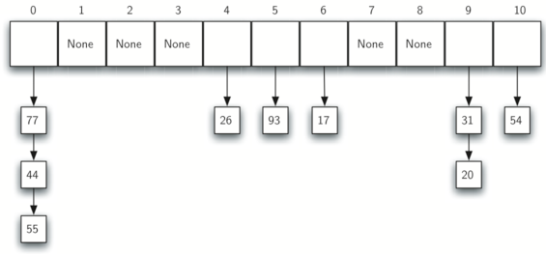
Chaining

Slide 31
Chaining
When we want to search for an item, we use the hash function to generate the slot where it should reside. Since each slot holds a collection, we use a searching technique to decide whether the item is present.
The advantage is that on the average there are likely to be many fewer items in each slot, so the search is perhaps more efficient. We will look at the analysis for hashing at the end of this section.

Slide 32
Basic Operations
Following are the basic primary operations of a hash table.
Search − Searches an element in a hash table.
Insert − inserts an element in a hash table.
delete − Deletes an element from a hash table.

Slide 33
Count Sort
Counting sort is a sorting technique based on keys between a specific range. It works by counting the number of objects having distinct key values (kind of hashing). Then doing some arithmetic to calculate the position of each object in the output sequence.
Counting sort assumes that each of the n input elements is an integer in the range 0 to k, for some integer k. When k=O(n), the sort runs in ϴ(n) time.

Slide 34
Count Sort
In the code for counting sort, we assume that the input is an array A[1…..n], and thus A.length = n. We require two other arrays: the array B[1…..n] holds the sorted output, and the array C[0….k] provides temporary working storage.

Slide 35
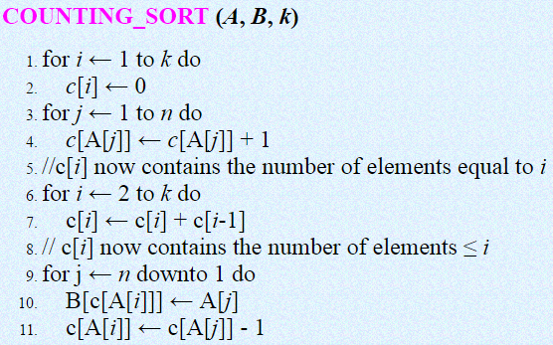
Count Sort
Here, we are given array A[1 . . n] of length n. We required two more arrays, the array B[1 . . n] holds the sorted output and the array c[1 . . k] provides temporary working storage.

Slide 36
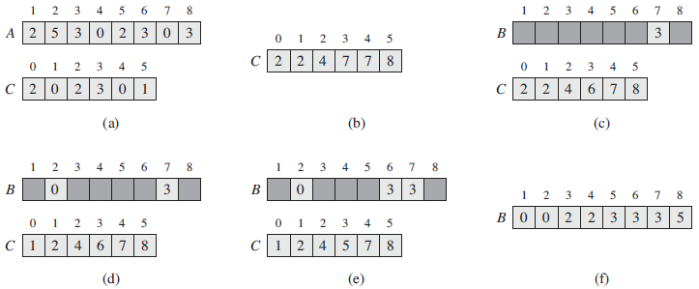
Count Sort
Illustration of count sort:

Slide 37
Count Sort
Figure (Previous slide)The operation of COUNTING-SORT on an input array A[1….8], where each element of A is a nonnegative integer no larger than k = 5.
(a) The array A and the auxiliary array C after line 4.
(b) The array C after line 7. Lines 6–7 determine for each i=0, 1,…., k how many input elements are less than or equal to i by keeping a running sum of the array C.
(c)–(e) The output array B and the auxiliary array C after one, two, and three iterations of the loop in lines 9–11, respectively. Only the lightly shaded elements of array B have been filled in.
(f) The final sorted output array B.

Slide 38
Count Sort
Analysis:
Counting sort assumes that each of the elements is an integer in the range 1 to k, for some integer k.
The loop of lines 1-2 takes O(k) time
The loop of lines 3-4 takes O(n) time
The loop of lines 6-7 takes O(k) time
The loop of lines 9-11 takes O(n) time
Therefore, the overall time of the counting sort is O(k) + O(n) + O(k) + O(n) = O(k + n)

Slide 39
The Radix Sort Algorithm
Example 1: Original, unsorted list:
170, 45, 75, 90, 802, 24, 2, 66
Sorting by least significant digit (1s place) gives: [Notice that we keep 802 before 2, because 802 occurred before 2 in the original list, and similarly for pairs 170 & 90 and 45 & 75.]
170, 90, 802, 2, 24, 45, 75, 66
Sorting by next digit (10s place) gives:
802, 2, 24, 45, 66, 170, 75, 90
Sorting by most significant digit (100s place) gives:
2, 24, 45, 66, 75, 90, 170, 802

Slide 40
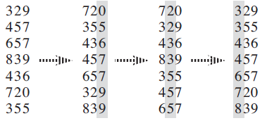
The Radix Sort Algorithm
Example 2:

Slide 41

The Radix Sort Algorithm
The following procedure assumes that each element in the n-element array A has d digits, where digit 1 is the lowest-order digit and digit d is the highest-order digit.

Slide 42

Huffman codes
Huffman codes compress data very effectively: savings of 20% to 90% are typical, depending on the characteristics of the data being compressed.
Suppose we have a 100,000-character data file that we wish to store compactly.

Slide 43
Huffman codes
Here, we consider the problem of designing a binary character code (or code for short) in which each character is represented by a unique binary string, which we call a codeword. If we use a fixed-length code, we need 3 bits to represent 6 characters: a = 000, b = 001, . . . , f = 101.
This method requires 300,000 bits to code the entire file. Can we do better?

Slide 44
Huffman codes
A variable-length code can do considerably better than a fixed-length code, by giving frequent characters short code words and infrequent characters long code words.
Figure shows such a code; here the 1-bit string 0 represents a, and the 4-bit string 1100 represents f. This code requires
(45. 1 + 13 .3 + 12 .3 + 16 .3 + 9 .4 + 5 .4). 1,000 =224,000 bits to represent the file, a savings of approximately 25%.

Slide 45
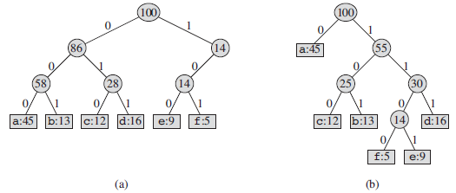
Huffman codes
(a) The tree corresponding to the fixed-length code a = 000, . . . , f = 101. (b) The tree corresponding to the optimal prefix code a = 0, b = 101, . . . , f = 1100.

Slide 46
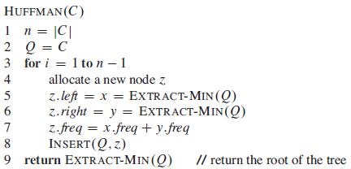
Huffman codes
we assume that C is a set of n characters and that each character c ϵ C is an object with an attribute c.freq giving its frequency.

Slide 47
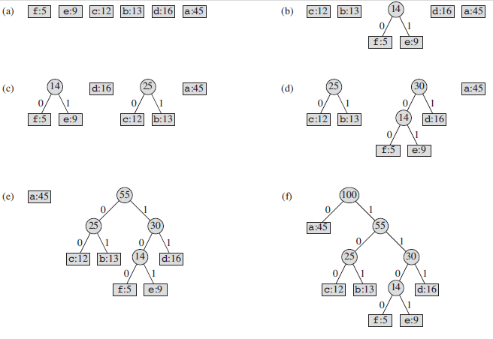
Huffman codes

Slide 48
Thank you

